Slide 1

Artificial Intelligence Project
Nonogram Puzzle Solver

Slide 2

Done by
Mohammad Hasnain
Mohammad Umar Raza
Mohid Arshad
BS(DS)-1

Slide 3
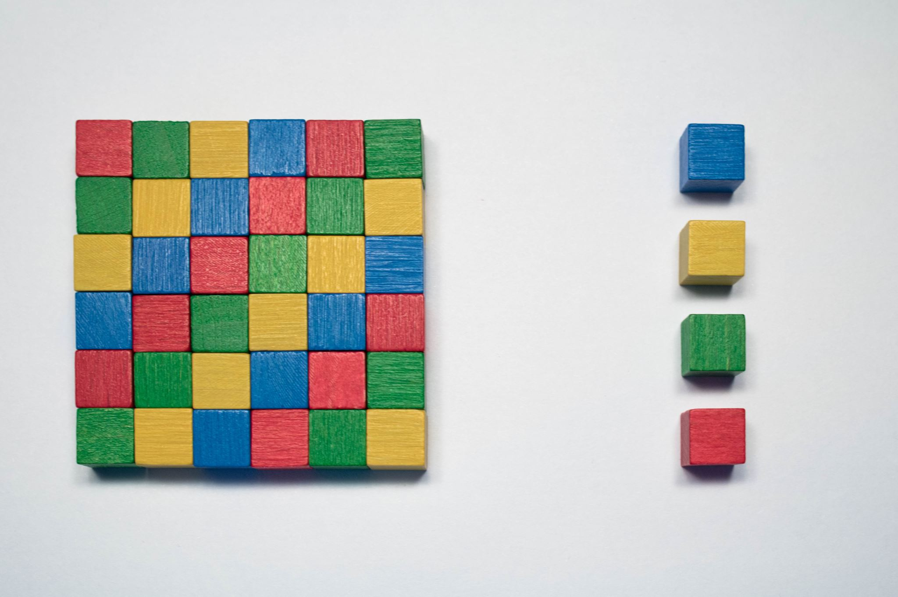
Project Overview
Nonogram is a grid-based logic puzzle where players fill cells based on row and column constraints. This project uses Artificial Intelligence techniques, including Simulated Annealing, to efficiently solve these puzzles.

Slide 4

Introduction
Nonograms are challenging puzzles that require matching grid cell patterns to constraints. Manual solving is time-consuming, and larger grids make solving harder. The goal is to develop an automated AI-based solver.

Slide 5

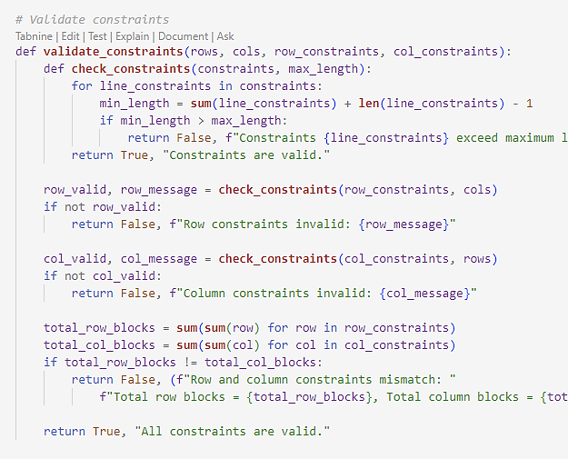
Constraints Validation
The solver validates by:
Ensuring the sum of blocks fits within the grid dimensions.
Checking row and column block sums match.
Verifying total blocks in rows and columns are consistent.

Slide 6
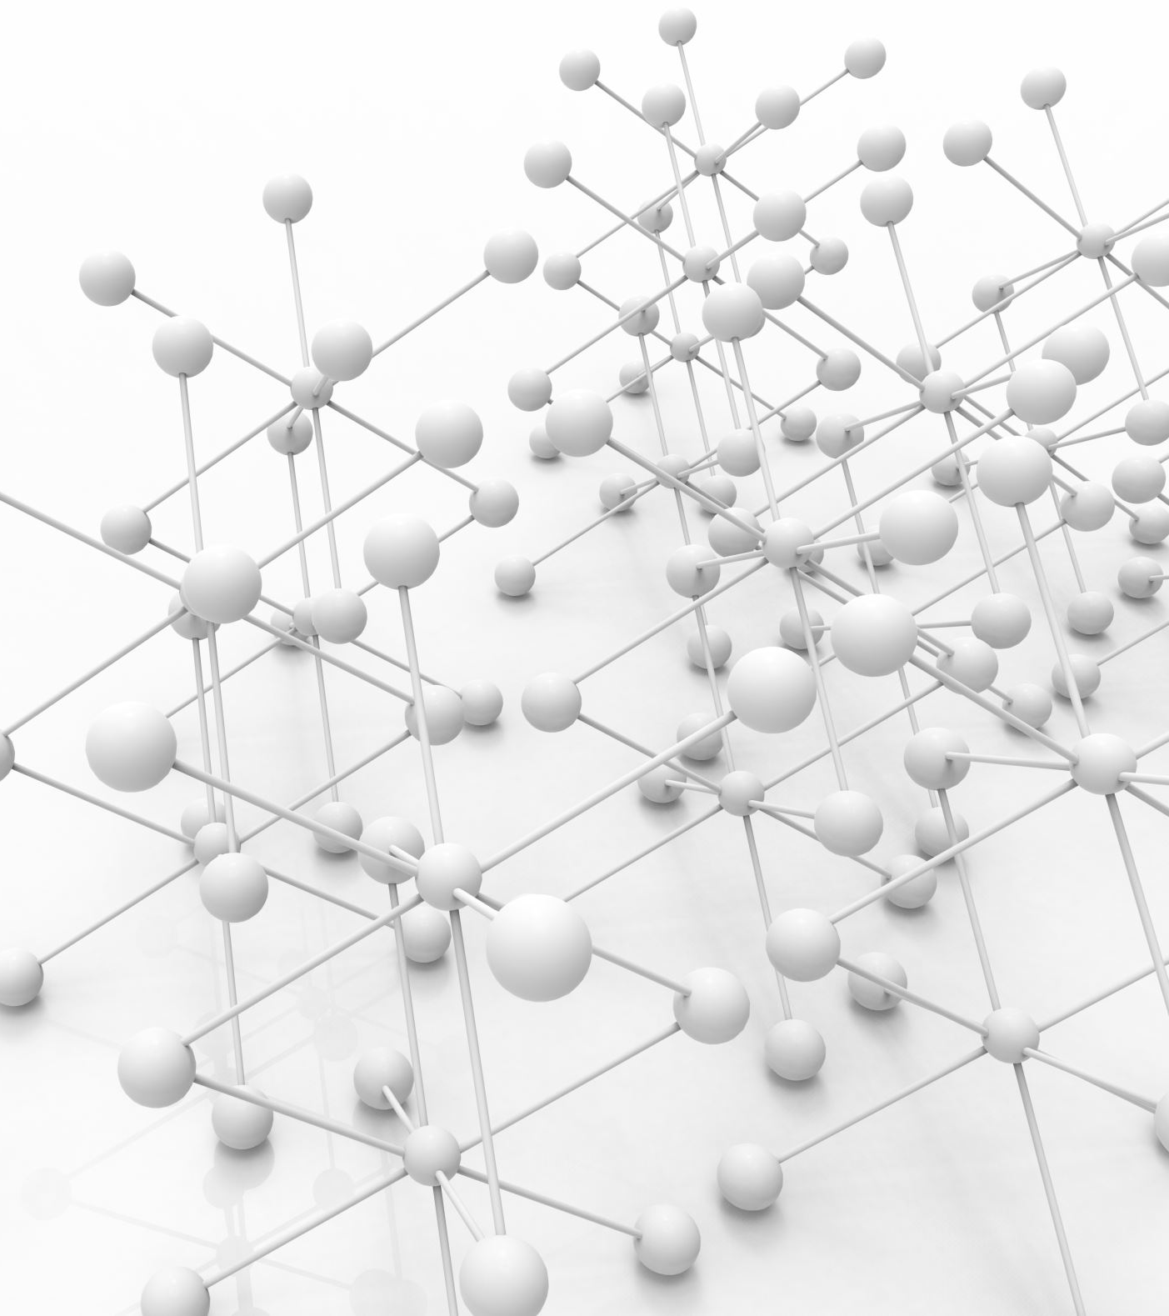
Algorithm Design
The AI solver uses the following steps:
Generate a random initial state.
Calculate fitness based on constraints.
Use Simulated Annealing to improve solutions iteratively.
Repeat until constraints are satisfied or iterations limit is reached.

Slide 7

Python Code Highlights
Key Python functions implemented:
random_initial_state(rows, cols): Generates random grids.
calculate_fitness(state, row_constraints, col_constraints): Computes solution quality.
simulated_annealing(): Optimizes solutions iteratively.
visualize_solution(): Displays solutions graphically using Turtle graphics.

Slide 8
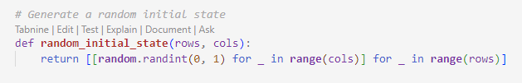
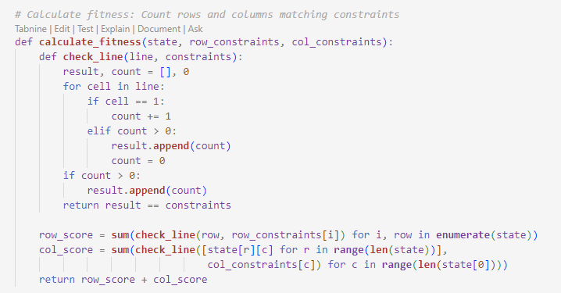
Code

Slide 9
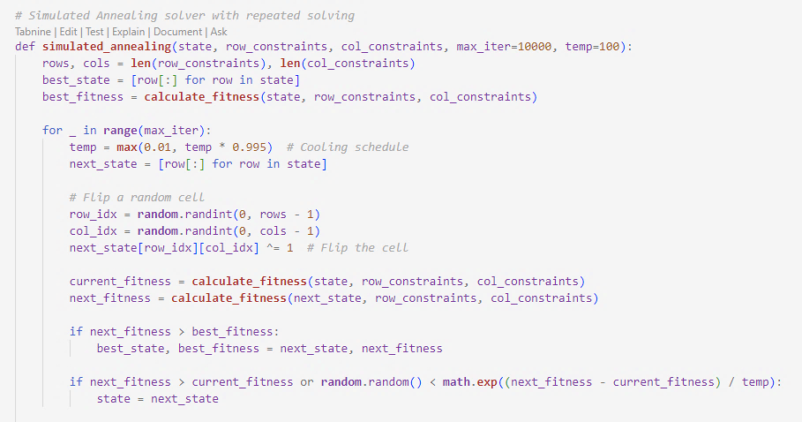
Code

Slide 10
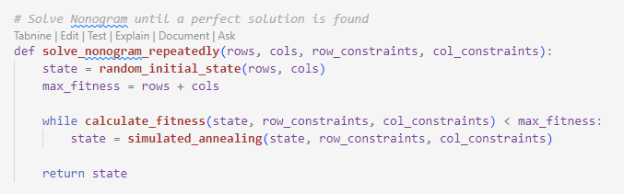
Code

Slide 11
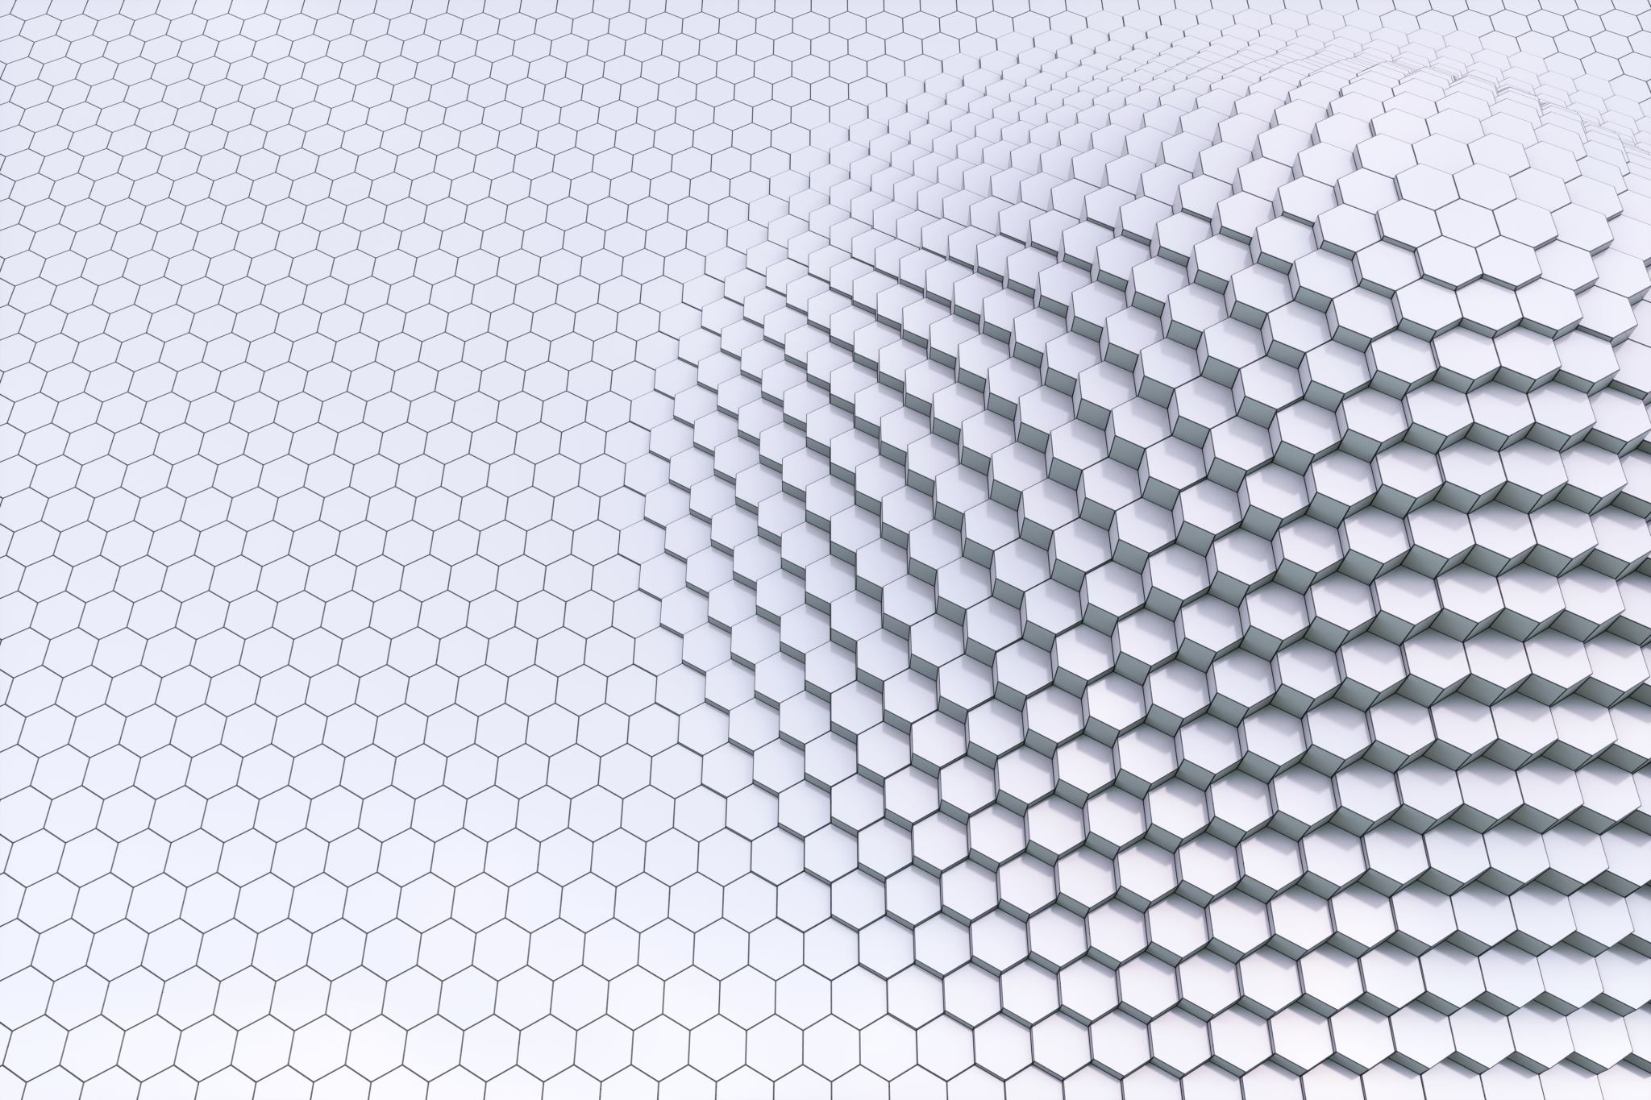
Solution Visualization
Using Turtle Graphics, solutions are visually represented as a grid. Filled cells are shaded, and empty cells are crossed.

Slide 12

Result
The solver successfully handles different Nonogram dimensions and constraints.
It achieves valid solutions by iteratively optimizing states and visually presents them.

Slide 13

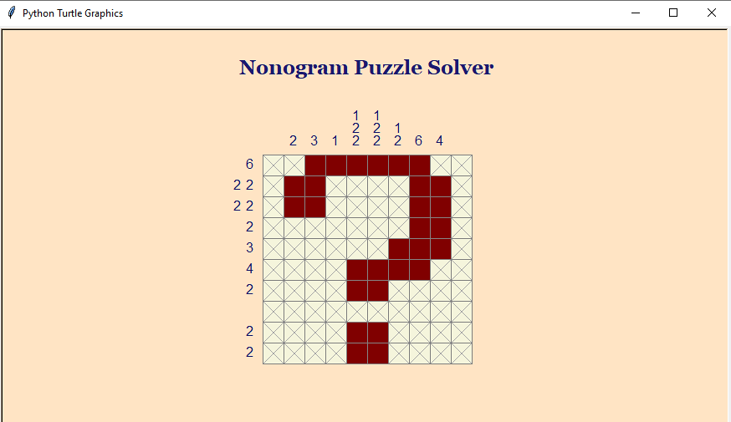
Visualization

Slide 14
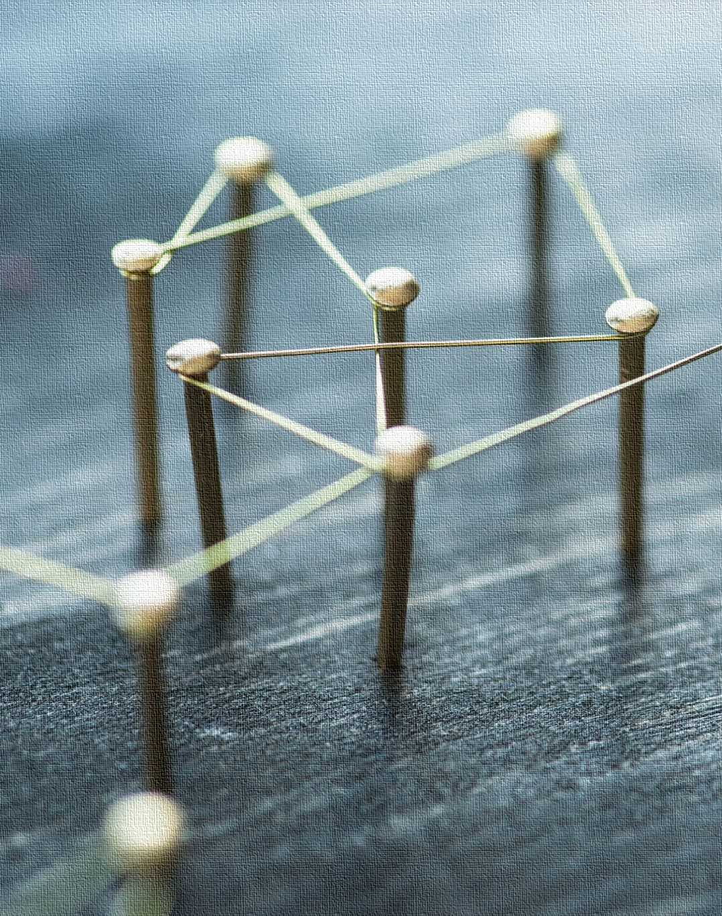
Challenges and Solutions
Challenges:
Validating constraints for large grids.
Ensuring convergence in Simulated Annealing.
Solutions:
Constraint validation functions ensure data integrity.
Adjusted cooling schedule and fitness logic for faster convergence.

Slide 15

Future Enhancements
Extend solver to handle larger grids efficiently (e.g., 25x25).
Integrate a GUI for user input and visualization.
Explore alternative optimization techniques like Genetic Algorithms.

Slide 16

Conclusion
The Nonogram Puzzle Solver demonstrates how Artificial intelligence algorithms can tackle complex puzzles. It also highlights Python's capabilities for logic, optimization, and visualization.

Slide 17

Thank You!
Any Questions?

